Slide 1
Instructional Video Games:
Overcoming Usability Barriers in the Classroom
Jessica L Barron, MA
Duquesne University

Slide 2
Session Overview
Why use Instructional Gaming?
Instructional Gaming: The Barriers
Discussion: Our Personal Experiences
Overcoming Barriers
Instructional Gaming Examples
Practice: Exploring the Possibilities

Slide 3
Why use Instructional Gaming?
Many instructors are turning to alternate teaching solutions to help bridge the gap in between hands on experiences and learning
“…the necessary goal of a well-designed sim-based program is to develop in the student a deep, flexible, intuitive, kinesthetic understanding of the subject matter.”
~Clark Aldrich

Slide 4

Why use Instructional Gaming?
Simply observing a model in action is not enough for a learner to retain all that they have learned. In order to truly retain their knowledge, they should demonstrate their skills through the following steps:
  Attention
  Retention
  Production
  Motivation
~Motivation in Education by Schunk, Pintrich, & Meece

Slide 5

Instructional Gaming: The Barriers
First Order Barriers: External
Lack of Hardware
Lack of Software
Lack of Professional
Development

Slide 6

Instructional Gaming: The Barriers
Second Order Barriers: Internal
Teachers’ confidence
Beliefs about how students learned
Perceived value of technology
"Teacher quality is the factor that matters most for student learning.“
~Darling-Hammond and Berry

Slide 7
Discussion: Barriers
Our Personal Experiences

Slide 8
Overcoming Barriers
Remedies for First Order Barriers: External
Seek out PC games
Apply for grants (iPad, software licenses, trainings)
Use educational version of games
Introduce ongoing and thorough professional development

Slide 9
Overcoming Barriers
Remedies for Second Order Barriers: Internal
Create a support structure for instructors
  Discuss and analyze theory
  Provide practical uses for video games
  Create and maintain technical support materials
      Lesson plans, instructions, and FAQ’s

Slide 10
Instructional Gaming Examples:
MineCraft
A “Sandbox” style game that provides an open environment for students to explore and learn
The game provides a custom modification to help instructors use the game effectively in the classroom
MineCraftedu can enable students to students apply their knowledge in technical and creative ways
“MineCraft is a clever, award-winning game for people of all ages that as has sold over eight million copies on PC and over twelve million copies across all platforms.”
-Alexandra Ding, StudentAdvisor.com

Slide 11
Instructional Gaming Examples:
MineCraft
Minecraft EDU http://minecraftedu.com/
Lesson Plans Include:
  Using Redstone to teach programming and electricity
  Engineering and Spatial Reasoning
  Multiplication skills and understanding the concepts of volume and area

Slide 12
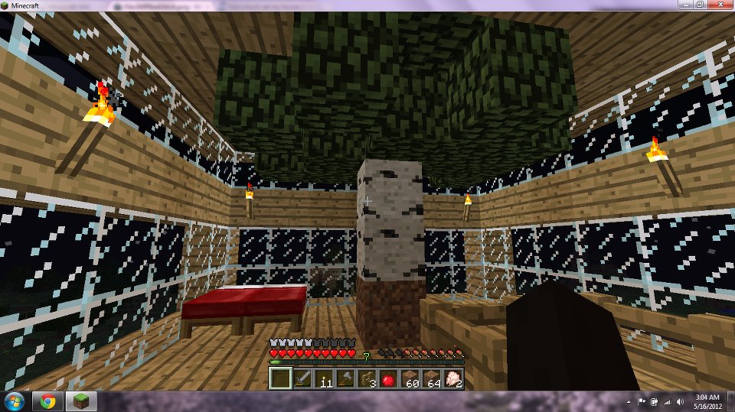
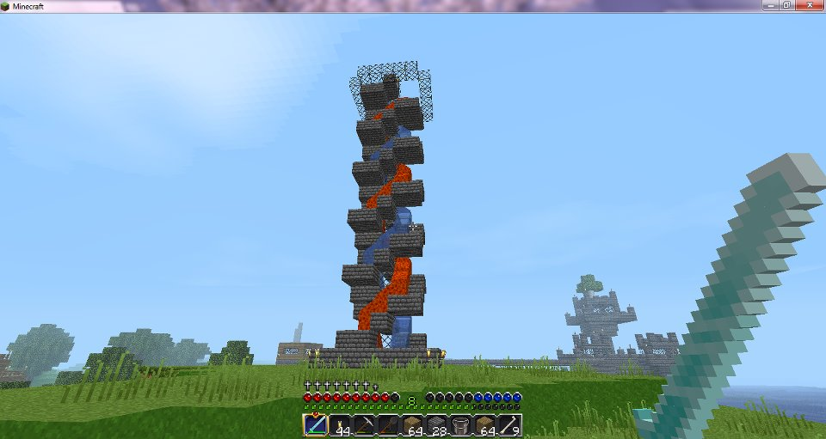
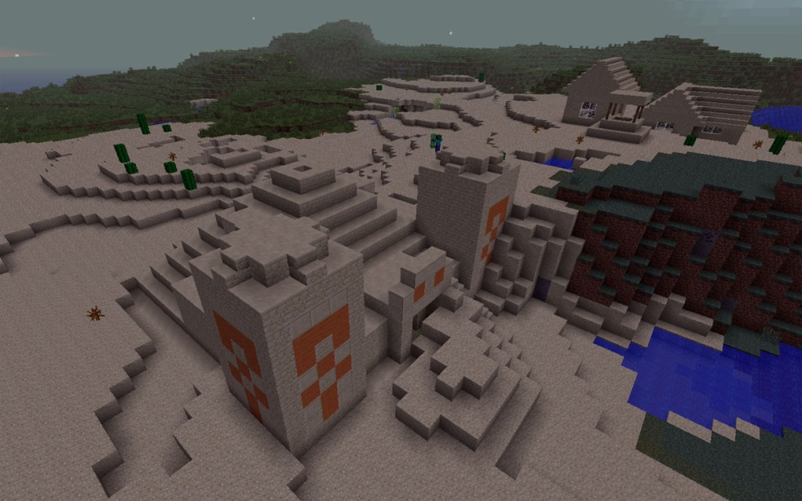
Instructional Gaming Examples:
MineCraft

Slide 13
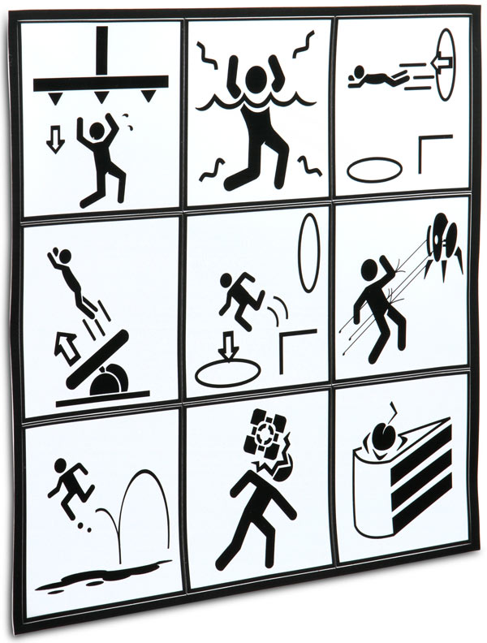
Instructional Gaming Examples:
Portal 2
Using Portal 2 in STEM education provides:
Person to person collaboration
The ability for learners to see actions and the consequences in real-time
They can also create their own levels using “Hammer” that their teammates can complete
www.thinkgeek.com

Slide 14
Instructional Gaming Examples:
Portal 2
Teach with portals: http://www.teachwithportals.com
Lesson Plans Include:
  The Broken Rooms (Math)
  Portal “Bouncing” and Oscillations, Lesson 1 & 2 (Physics)
  Terminal Velocity
  Introduction to Parabolas with the Puzzle Maker

Slide 15
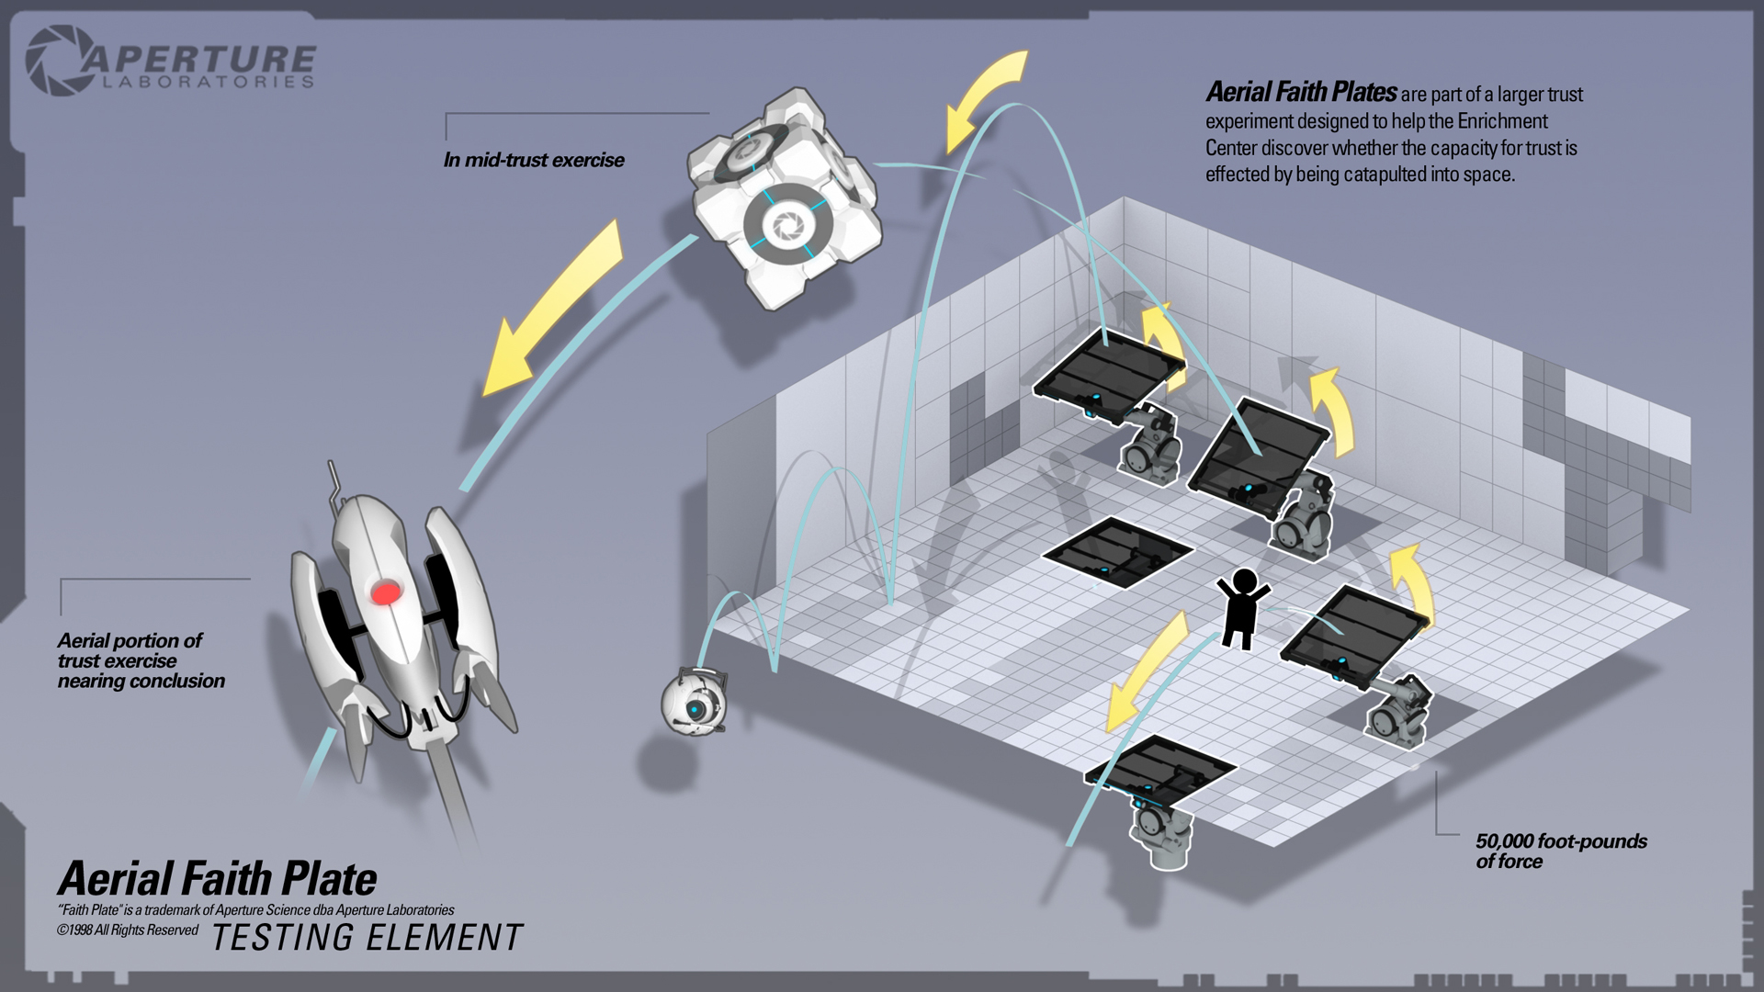
Instructional Gaming:
Portal 2
www.teeworlds.com

Slide 16
Instructional Gaming Examples:
SimCity
In order to meet the demand to make STEM education more engaging, EA, Maxis and the GlassLab collaborated and modified EA’s SimCity game for educational use.
The initiative is to attract students to high paying jobs within STEM

Slide 17
Instructional Gaming Examples:
SimCity
SimCity EDU http://www.simcityedu.org/ and http://glasslabgames.org/
Lesson Plans include:
    Building Blocks: Geometry & Math-Minded (Sim)City Building
    Power to the People: Energy Consumption, Costs & Consequences
    Pollution Challenge: Fixing a city in distress

Slide 18


Instructional Gaming Examples:
SimCity

Slide 19
Practice
Exploring the Possibilities

Slide 20
References
Aldrich, C. (2005). Learning by doing: A comprehensive guide to simulations, computer games, and pedagogy in e-learning and other educational experiences. San Francisco: Pfeiffer.
Barab, S. A., Gresalfi, M., & Arici, A. (2009). Why educators should care about games. Educational Leadership 67(1), pp. 76--80.
Bleah, Joel. "Using Simulations to Learn Principles of Geometry and Civil Engineering." BrainMeld.org. Sept. 2005. Web. 18 Jan. 2011.
Ertmer, P. A. (1999). Addressing first- and second-order barriers to change: Strategies for technology integration. Educational Technology, Research and Development, 47(4), 47-61. ProQuest Education Journals.
Gee, J.P (2005) Learning by Design: good video games as learning machines, E-Learning and Digital Media, 2(1), 5-16.
Hyatt, K.J., Barron, J.L., Noakes, M.A. (2012). Video gaming for STEM education. In S. Wang and H. Yang (Ed.), Cases on Formal, Non-Formal, and Informal Online Learning: Opportunities and Practices

Slide 21
References
Klietsch, R. G. (1969). An introduction to learning games & instructional simulations: A curriculum guide. Newport, MN: Instructional Simulations.
Park, S. H., & Ertmer, P. A. (2008). Examining barriers in technology-enhanced problem-based learning: Using a performance support systems approach. British Journal of Educational Technology, 39, 631-643.
Schunk, D. H., Pintrich, P. R., & Meece, J. L. (2008). Motivation in Education: Theory, Research, and Applications (3rd ed.). Upper Saddle River, NJ: Pearson Merrill-Prentice Hall.
Snowman, J., McCown, R. R., & Biehler, R. F. (2009). Psychology applied to teaching. Boston: Houghton Mifflin.
Wood, E., Mueller, J., Willoughby, T., Specht, J., & Deyoung, T. (2005). Teachers’ Perceptions: barriers and supports to using technology in the classroom. Education, Communication & Information, 183-206.

