Slide 1

Stages of Life

Slide 2

Choose your own journey!
The following slides are going to take you on a journey through the stages of life. Feel free to return to the clearing at any time to take another path.
Click the arrow to continue….

Slide 3
Navigation
There are navigation buttons for every page
Click on the arrows to go forward or back.
Click on the home to return to the “Choose your path” slide.
Click the arrow to continue….

Slide 4

Click on the arrow to choose your path…

Slide 5


Butterfly
Tiny eggs are laid by the female on a leaf. Around 5 days later, a tiny wormlike creature will hatch.

Slide 6

Butterfly
The caterpillar is the primary eating and growth stage of the insect.

Slide 7


Butterfly
The pupa or chrysalis is the resting or transformation stage, and within it the marvelous transformation from caterpillar to adult takes place. Then the adult emerges from the chrysalis.

Slide 8
Butterfly
A butterfly has emerged! The pupa skin splits, the limp, damp butterfly crawls out. A little warming from the sun and it is now ready to fly off to feed and then lay its eggs.
CLICK HERE TO REVIEW

Slide 9
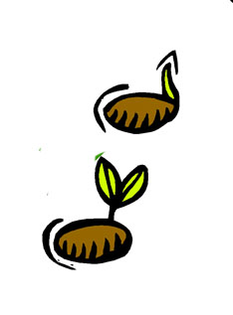
Plant
A plant begins as a simple seed. When planted in the ground, the seed will germinate and begin to grow. The tiny root will work its way down as the tiny stem works its way up.

Slide 10

Plant
The small plant that first makes its appearance is the seedling. It has a small, vulnerable stem with a few small leaves.

Slide 11

Plant
With sunlight and water, this seeding will grow larger and more mature. The stem and root will grow longer, and new leaves will appear on the plant.

Slide 12
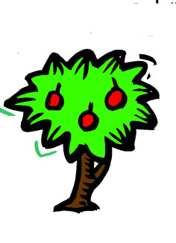
Plant
When the plant reaches maturity, flowers will form. The flower is different for each plant, yet all contain the same basic parts. Some plants protect the seeds inside a fruit that houses the seeds until they are ready.
CLICK HERE TO REVIEW

Slide 13

Frog
Frogs lay their eggs in water or wet places. A floating clump of eggs is called frog spawn.

Slide 14

Frog
After its 21 day development period, the embryo attaches itself to a weed in the water. This quickly becomes a tadpole, a baby frog. hey eat very small plants that stick to larger plants in the water. The tadpole has a long tail, and lives in the water.
.

Slide 15
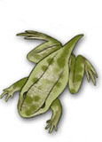
Frog
After about five weeks, the tadpole begins to change. It starts to grow hind legs, which are soon followed with forelegs. Lungs begin to develop, preparing the frog for its life on land.

Slide 16
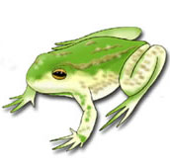
Frog
Eleven weeks after the egg was laid, a fully developed frog with lungs, legs, and no tail emerges from the water. This frog will live mostly on land, with occasional swims. The tiny frogs begin to eat insects and worms.
CLICK HERE TO REVIEW

Slide 17
Butterfly
Review Question 1
What does a butterfly start out as?
A. Caterpillar
B. Egg
C. Pupa
D. Insect

Slide 18
Butterfly
Review Question 2
What is the special stage called when a caterpillar transforms?
A. Growth Stage
B. Adult Stage
C. Chrysalis Stage
D. Emergent Stage

Slide 19
Frog
Review Question 1
A tadpole starts out with four legs.
TRUE
FALSE

Slide 20
Frog
Review Question 2
How many weeks does it take for a frog to fully develop from a tadpole?
A. 5 weeks
B. 11 days
C. 15 days
D. 11 weeks

Slide 21
Plant
Review Question 1
When the seed begins to sprout roots, it is called a ______.
A. Sapling
B. Seed
C. Seedling
D. Tree

Slide 22
Plant
Review Question 2
Some plants protect their seed inside a ________.
A. Nest
B. Fruit
C. Casing
D. Leaf

Slide 23

CORRECT!!!
Return to….
Question 1
Question 2

Slide 24
INCORRECT
Click the graphic to review the stages again…
Return to….
Question 1
Question 2

Slide 25
CORRECT!!!
Return to….
Question 1
Question 2

Slide 26
INCORRECT
Click the graphic to review the stages again…
Return to….
Question 1
Question 2

Slide 27
CORRECT!!!
Return to….
Question 1
Question 2

Slide 28
INCORRECT
Click the graphic to review the stages again…
Return to….
Question 1
Question 2

