Slide 1
KTI Technology Professional Development
Jessica L Barron, MA
GDIT 709
Instructional Program Development
Jonathan Barkand

Slide 2
Overview
Description of Program
Instructional Strategy
Prototype
Summative Assessment

Slide 3
Description of Program
The faculty of KTI does not have adequate training available for the integration of technology into their classrooms.
Training modules will provide concrete examples of how to use technology in the classroom and in lab settings.
The purpose of the program is to provide the following:
Needs assessment
Training on current and new technologies
Support for current and new technologies
Specific in-class examples

Slide 4
Description of Program Population
30+Full Time Faculty, 15+ Adjunct Faculty, ages 26-55
Varied programs, specializing in areas like medical, culinary and massage
Varied Educational background
Classrooms are either lab or lecture style
Technology is not widely used or embraced

Slide 5
Description of Program Similar Programs
Studies also show that professors are more satisfied with technology if they have received training. In addition, professors are more likely to accept technology training if provided with an incentive” (Rhodes & Goveia 2002)
Common Goals of similar programs
Reduce stress and anxiety about using new techniques in the classroom
Provide a online training platform to present modules with convenience in mind
Introduce new technologies into the classroom and lab setting that makes sense and aids instruction

Slide 6
Description of Program Program Personnel
Developer/Designer: The developer/designer will be the primary role in this program.
Facilitator: The facilitator should be able to lead a classroom and understand the program completely in order to provide successful instruction.
Administrative Advisor: This role will be held by the Dean of Education.

Slide 7
Instructional Strategy
Goals/Objectives contained within courses/modules/sessions:
Increase awareness of the variety of technological solutions available to staff and faculty
Provide techniques and strategies to integrate technology effectively into the curriculum
Develop staff proficiency in technology
To enhance student achievement through the effective use of technology in and out of the classroom
Promote effective and efficient use of technology by faculty and staff

Slide 8
Prototype Outline of Instruction
Quarter 1: November 4, 2011 Google email and applications, PowerPoint presentations
Quarter 2: March 2, 2012 Online classroom/grading systems
Quarter 3: July 13, 2012 Web 2.0 tools: Wikis, Blogs and Social Networking
Quarter 4: November 2, 2012 Creating and uploading videos

Slide 9
Prototype Outline of Instruction
Online Modules
Attendance recording: How to log in and record attendance on STARS
Using the gradebook on the server: The features of the local excel gradebook
How to map a drive on the network
How to create a lesson plan using the word template
More as announced

Slide 10
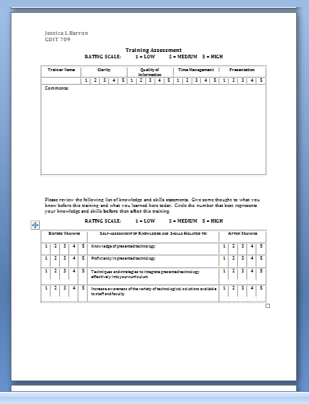
Prototype Assessment
Feedback will be collected after each module
A training assessment tool (right) will be distributed, filled out and then collected
Results will be compiled and analyzed

Slide 11
Summative Assessment
Congruence analysis: Verification of data by using more than one assessment instrument to measure performance
Content analysis: Objective evaluation of the content presented within the modules
Design analysis: Evaluation of the design principles employed in the modules
Feasibility analysis: Strength and weaknesses of the program is assessed and the resources available to make the program succeed are considered

Slide 12
Field Trial
Planning/Preparation: Summaries and introduction of the online modules will be created
Implement/Collect Data: Assessments will be completed and analyzed
Summarize and Analyze Data: Results will be calculated and appropriate changes will be made
Reporting Results: Results will be compiled and reported

Slide 13
Conclusion
“A great leader's courage to fulfill his vision comes from passion, not position.” ~John Maxwell

Slide 14
Research
Rhodes, C., & Goveia, W. (2002). Faculty training initiative at the indiana university school of education: a participative effort. Proceedings of the 30th Annual ACM SIGUCCS Conference on User Services, New York, 114-121. doi: 10.1145/588646.588671
Putman, L., & Wills, B. (2002). A new direction: improved methods for marketing faculty and staff technology training. Proceedings of the 30th Annual ACM SIGUCCS Conference on User Services, New York, 103-105. doi: 10.1145/588646.588668

