Slide 1
Culture and Poverty
D. Strahler ~ J. Barron ~ A. Wasilko

Slide 2
Overview
Connections to Social Justice
Poverty in Education
Culture and Diversity
School Showcase
Solutions for our future

Slide 3
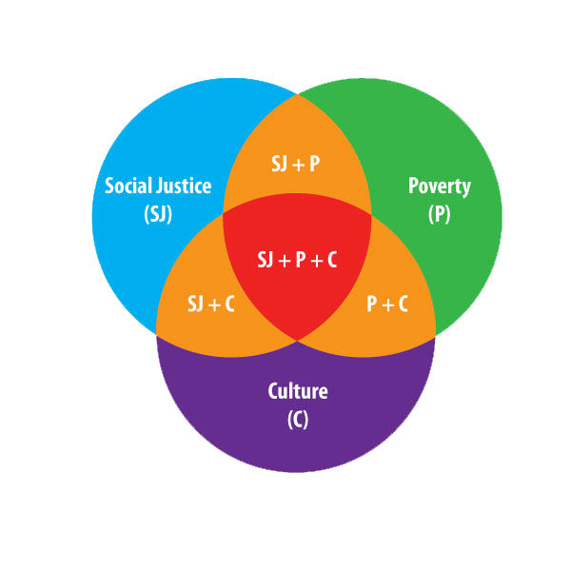
Connections to Social Justice

Slide 4
Defining Poverty
The extent to which an individual does without resources
Financial
Emotional
Mental
Spiritual
Physical
Support systems
Relationships/Role Models
Payne, R.K. (2005). A Framework for Understanding Poverty. Aha! Process, Inc: Highlands, Texas.
Notes:
Financial is a major factor, but does not explain all the resources to help one leave poverty.

Slide 5
Key Points on Poverty
Poverty is relative
Poverty occurs in all races and in all countries
Economic class is a continuous line, not a clear-cut distinction
Generational poverty and situational poverty are different
This work is based on patterns. All patterns have exceptions.
An individual brings with him/her the hidden rules of the class in which he/she was raised
Payne, R.K. (2005). A Framework for Understanding Poverty. Aha! Process, Inc: Highlands, Texas.

Slide 6
Key Points on Poverty
Schools and businesses operate from middle-class norms and use the hidden rules of middle class
Two things that help one move out of poverty are education and relationships
Four reasons one leaves poverty are:
It’s painful to stay
A vision or goal
A key relationship
A special talent or skill
Payne, R.K. (2005). A Framework for Understanding Poverty. Aha! Process, Inc: Highlands, Texas.

Slide 7
Culture & Education
Culture is vaguely “a group’s norms and values, as its attitudes toward work and family, or as its observed patterns of behavior” (Lamont & Small, 2008)
Use of culture & race interchangeably due to lack of depth and precision – used to distinguish one racial group from another (Lewis, O’Conner, & Mueller, 2005; Lamont & Small)
“Thus, breaking down culture into many components is essential if we are to better understand its role in channeling racial disparities” (Lamont & Small, 2008, p.90)

Slide 8
School Showcase: Urban Detroit
Effort has been made to make a difference in the gender gap that exists with urban African American boys
After Standards and Project Based Science Curricula was initiated, increase in tests scores was documented
When the curricula was aligned to standards and centered on specific learning goals, student achievement was made possible
Geier, R., Blumenfeld, P., Marx, R., Krajcik, J., Fishman, B., & Soloway, E. (2004). Standardized Test Outcomes of Urban Students Participating in Standards and Project Based Science Curricula. ICLS '04 Proceedings of the 6th International Conference on Learning Sciences, 206-213.

Slide 9
School Showcase: Urban Detroit
“Implementing standards-based instructional practice in large urban school systems presents a particular set of challenges for educators and their partners in reform efforts. These challenges include lack of resources, high levels of poverty, low student achievement, below grade level English proficiency, high student mobility, attendance problems, and difficulty recruiting and retaining highly qualified teachers.”
~Lynch 2000, Hannaway & Kimball, 2001; Kahle, Meece, & Scantlebury, 2000
Geier, R., Blumenfeld, P., Marx, R., Krajcik, J., Fishman, B., & Soloway, E. (2004). Standardized Test Outcomes of Urban Students Participating in Standards and Project Based Science Curricula. ICLS '04 Proceedings of the 6th International Conference on Learning Sciences, 206-213.

Slide 10
School Showcase: Urban Detroit
Three projects were implemented in order to meet learning goals
“What is the quality of air in my community?”
“What is the water like in my river?”
“Why do I have to wear a helmet when I ride my bike?
Support technologies used included:
Model-It
Artemis
eChem
Geier, R., Blumenfeld, P., Marx, R., Krajcik, J., Fishman, B., & Soloway, E. (2004). Standardized Test Outcomes of Urban Students Participating in Standards and Project Based Science Curricula. ICLS '04 Proceedings of the 6th International Conference on Learning Sciences, 206-213.

Slide 11
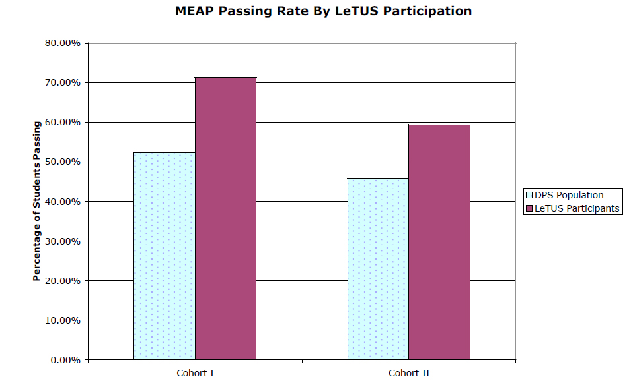
School Showcase: Urban Detroit
Geier, R., Blumenfeld, P., Marx, R., Krajcik, J., Fishman, B., & Soloway, E. (2004). Standardized Test Outcomes of Urban Students Participating in Standards and Project Based Science Curricula. ICLS '04 Proceedings of the 6th International Conference on Learning Sciences, 206-213.

Slide 12
Solutions for our Future
The $100 Laptop: “One Laptop per Child (OLPC) attempts to bridge the ―digital divide‖ between the rich and the poor, especially in third-world countries.”
LAMP (Louisiana Alliance for Minority Participation Program): A mentorship program involving engineering graduate students and students from minority colleges.

Slide 13
Conclusion
I consider this an important experience since the students who never thought that they could even see a college due to the financial or social conditions they had in their families, or were lost in the darkness of drugs and crimes, managed to get a focus in their lives.
~Uvais A Qidwai, Department of Computer Science and Engineering

Slide 14
References
Geier, R., Blumenfeld, P., Marx, R., Krajcik, J., Fishman, B., & Soloway, E. (2004). Standardized Test Outcomes of Urban Students Participating in Standards and Project Based Science Curricula. ICLS '04 Proceedings of the 6th International Conference on Learning Sciences, 206-213.
Harris, D. (2012). The $100 laptop: A cyberspace playground. ACM SIGCAS Computers and Society, 40(1), 23-27. doi: 1750888.1750891
Lamont, M., & Small, M. L. (2008). How culture matters: Enriching our understanding of poverty. In A. Lin & D. Harris (Eds.), The Colors of Poverty: Why Racial and Ethinic Disparities Persist (pp. 76-102). New York: Russell Sage Foundation.
Lewis, A., O'Conner, C., & Mueller, J. (2005). Discrimination, culture, or capital? the challenges of underconceptualizing race in educational research. In W. Ayers, T. Quinn & D. Stovall (Eds.), Handbook of Social Justice in Education (pp. 257-260). New York, NY: Routledge.
Payne, R. K. (2005). A framework for understanding poverty. Highlands, TX: aha! Process, Inc.
Qidwai, U. A. (2007). A LAMP-LEGO experience of motivating minority students to study engineering. ACM SIGCSE Bulletin, 39(4), 41-44. doi: 1345375.1345411

